Slide 1
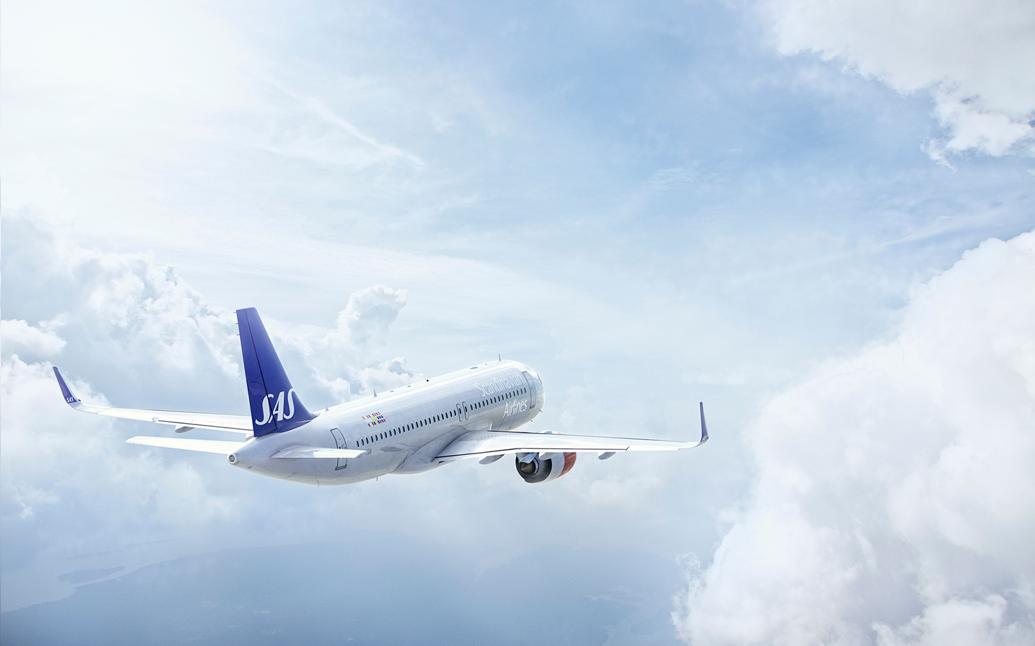
Predicting Airline
departure delay
Presented by-
Kinchal Sharma Tandon
Sneha Lokhare
Rohan Salian
Shruti Dhruv

Slide 2
Introduction
Delays cost 32.9 billion dollars to passengers, airlines and other parts of the economy
More than half of that amount comes from the pockets of passengers who lose time waiting for their planes to leave.
They also miss connecting flights, spend money on food and have to sleep on hotel rooms while they're stranded.

Slide 3
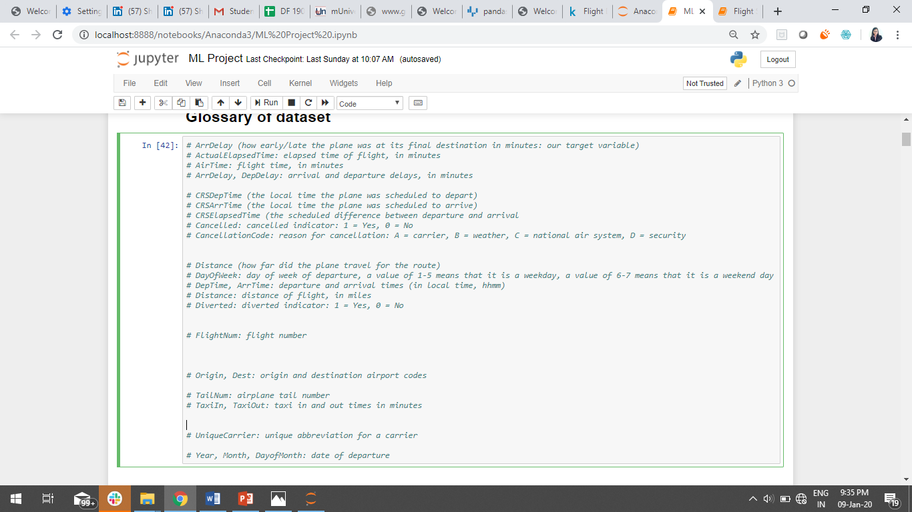
Dataset Description

Slide 4
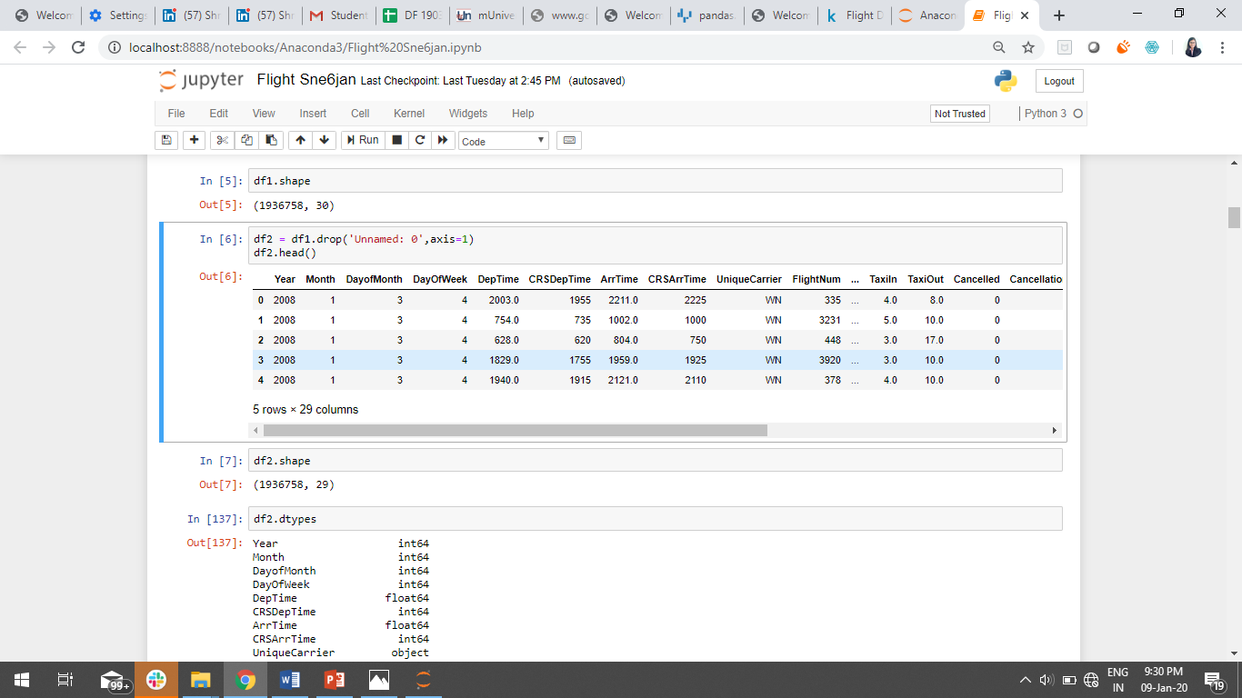
Dataset
19Lac + rows
30 columns
Year 2008 dataset

Slide 5
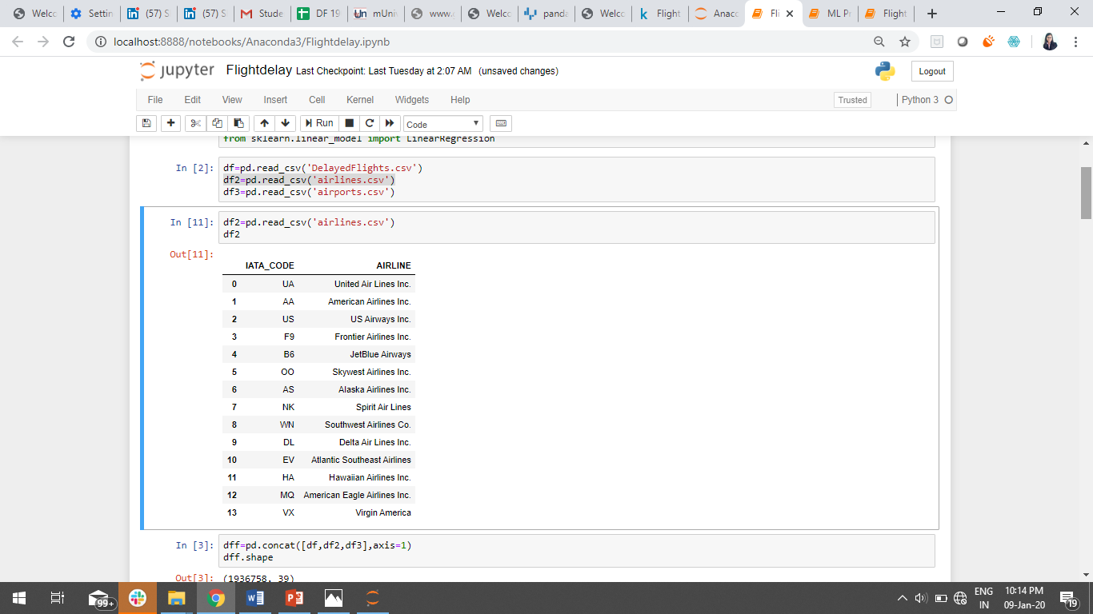
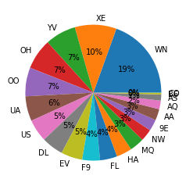
EDA
Proportion of Airlines

Slide 6
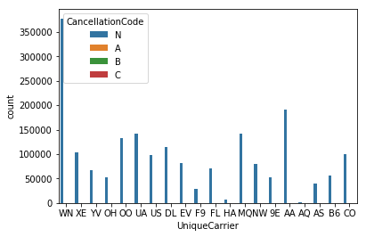
Airlines that gets cancelled CancellationCode: reason for cancellation: A = carrier, B = weather, C = national air system, D = security,N=not cancelled

Slide 7
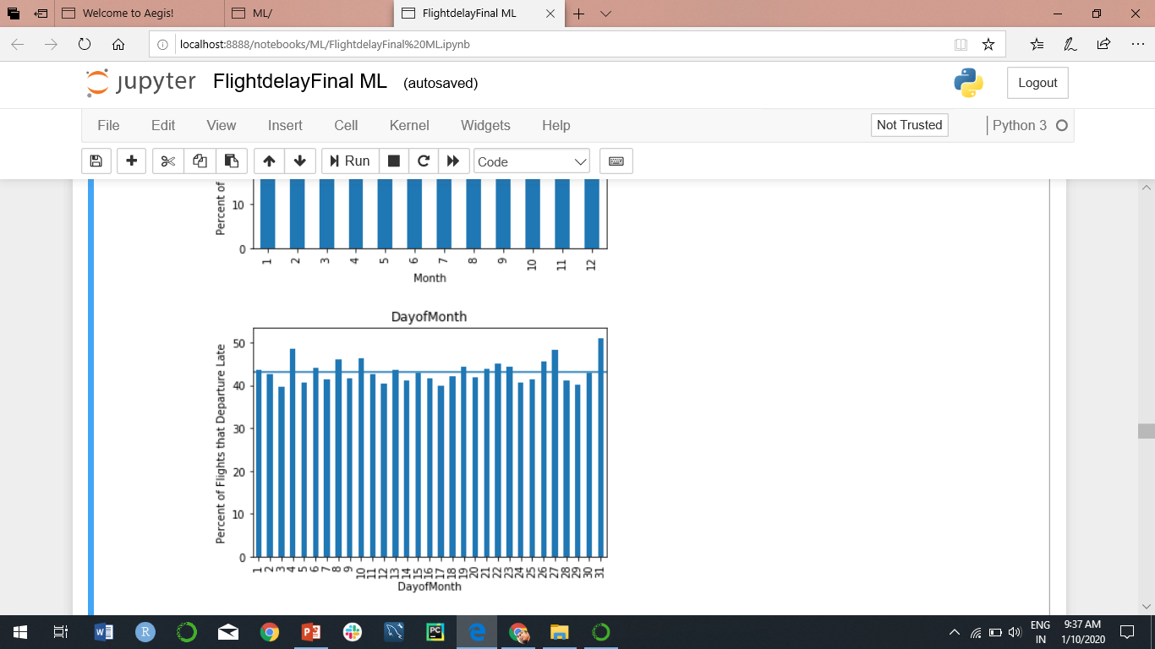
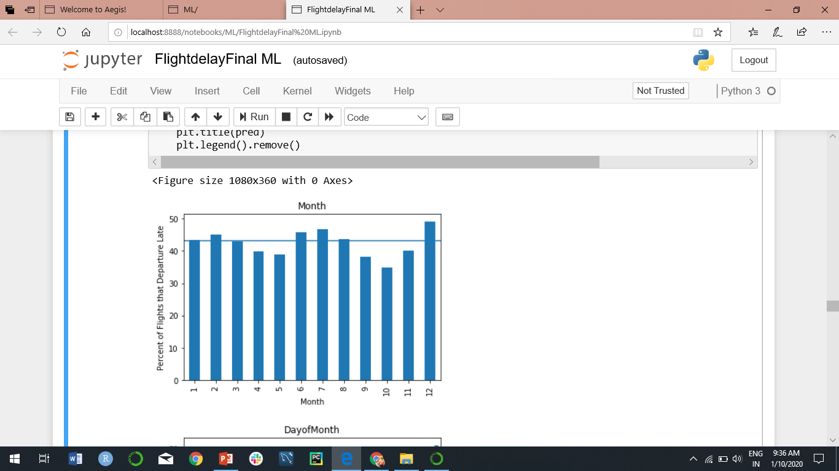
Monthly, Weekly Delays
Month wise Plot
Day wise plot of a month

Slide 8
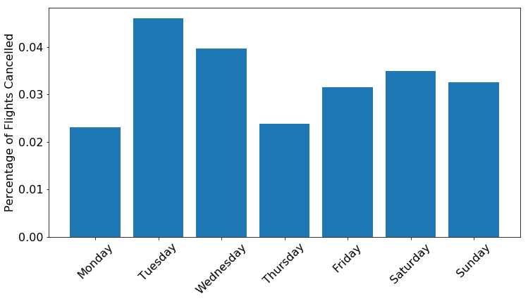
Weekly Plot of Cancelled Flight
This shows that Tuesday has the highest percentage of cancelled flights, and Monday has the lowest

Slide 9
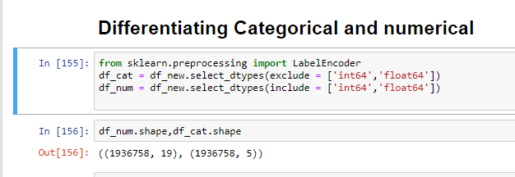
Feature Selection
5-categorical Variables
19-Numeric Variables

Slide 10
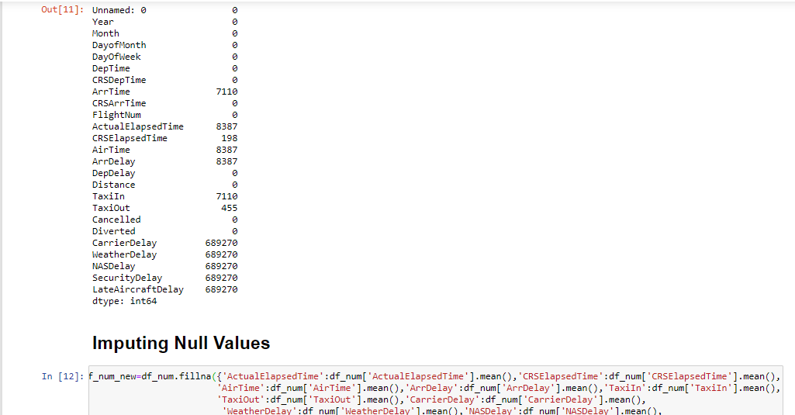
Handling Null Values

Slide 11
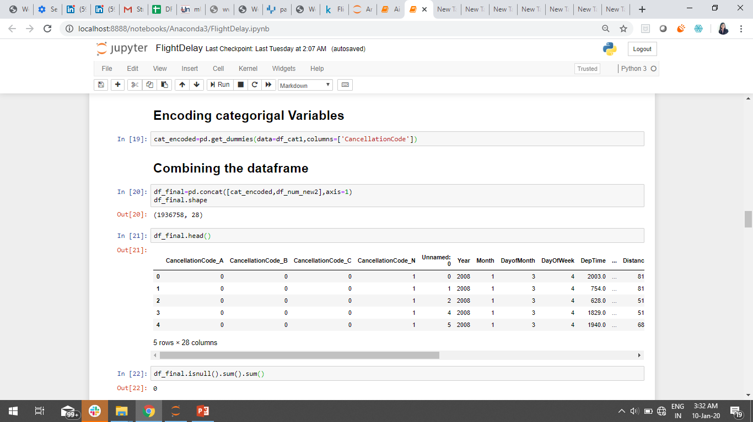
After Preprocessing

Slide 12
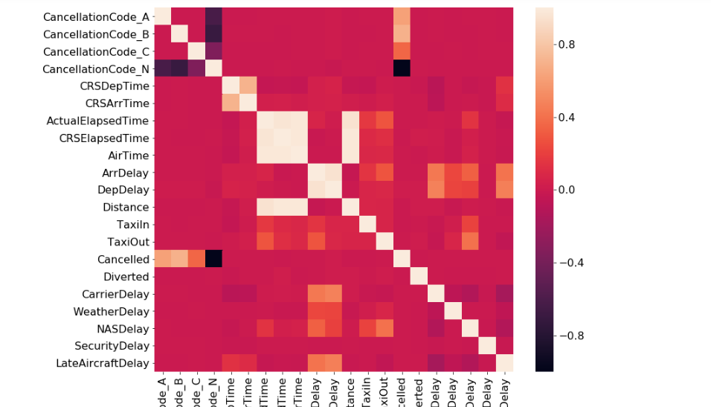
Check Multicolinearity
We find that some features are correlated so we try to find features that are related to target variable i.e DepDelay.

Slide 13
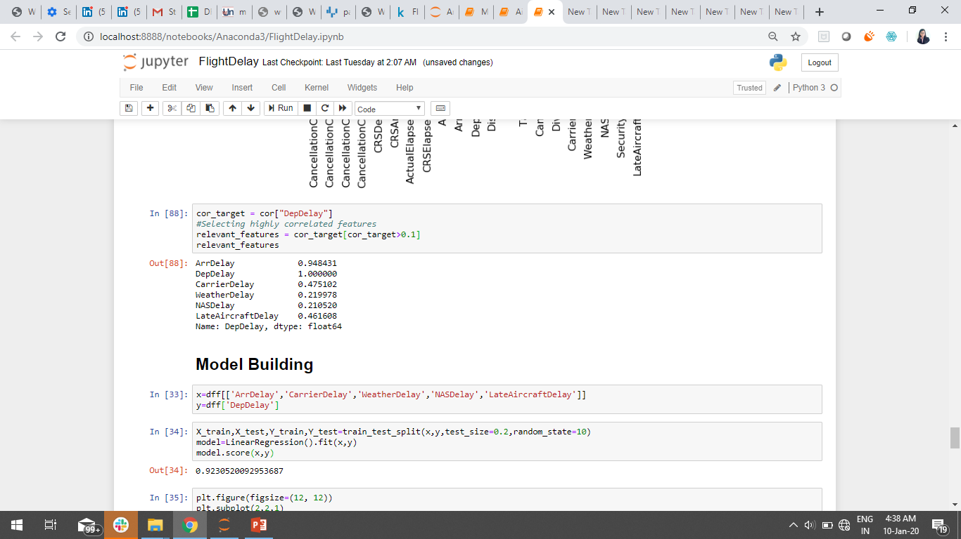
Feature selection and Model Building

Slide 14
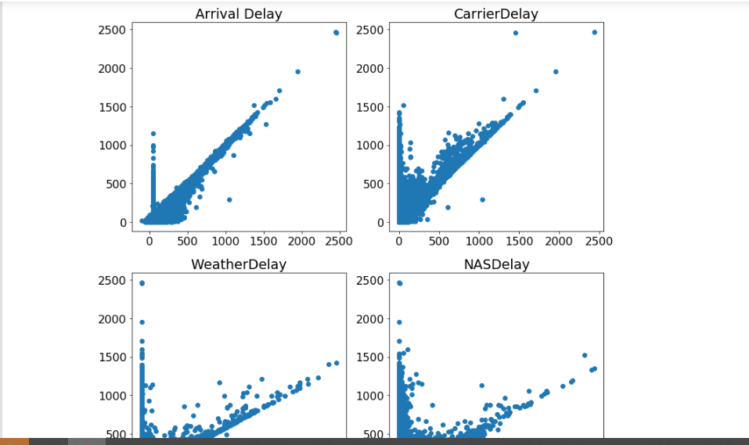
Final Analysis
Arrival Delay is highly correlated to Departure delay followed by Carrier Delay, Weather Delay and NASDelay.

Slide 15


